Slide 1
Module 3
Error

Slide 2
Error Term
An error term is a residual variable produced by a statistical or mathematical model, which is created when the model does not fully represent the actual relationship between the independent variables and the dependent variables.
As a result of this incomplete relationship, the error term is the amount at which the equation may differ during empirical analysis.
The error term is also known as the residual, disturbance, or remainder term, and is variously represented in models by the letters e, ε, or u.

Slide 3
Error Term
An error term represents the margin of error within a statistical model; it refers to the sum of the deviations within the regression line, which provides an explanation for the difference between the theoretical value of the model and the actual observed results.
Although the error term and residual are often used synonymously, there is an important formal difference.
An error term is generally unobservable and a residual is observable and calculatable, making it much easier to quantify and visualize.
In effect, while an error term represents the way observed data differs from the actual population, a residual represents the way observed data differs from sample population data.

Slide 4
Comparing model predictions against actual values
The difference between the actual value and the model’s estimate a residual.
Calculate the residual for every point in the data set, and each of these residuals will be of use in assessment.
These residuals will play a significant role in judging the usefulness of a model.
If the collection of residuals are small, it implies that the model that produced them does a good job at predicting the output of interest. Conversely, if these residuals are generally large, it implies that model is a poor estimator.

Slide 5
Comparing model predictions against actual values
But the dataset may contain million of readings.
Hence need to have measurements that take these collection of residuals and condense them into a single value that represents the predictive ability of our model.

Slide 6
R-squared ( R²) or Coefficient of determination
The R-squared statistic assesses how well a linear regression model fits the data.
It is a measure that provides information about the goodness of fit of the regression model.
It is a statistical measure that tells how well the plotted regression line fits the actual data. R squared measures how much the variation is there in predicted and actual values in the regression model.
Higher Value of R square signify lesser difference between actual and predicted value.
A lower value of R square signify greater difference between actual and predicted value (more error)

Slide 7
R-squared ( R²) or Coefficient of determination
R-squared values ​​range from 0 to 1, usually expressed as a percentage from 0% to 100%.
And this value of R square tells you how well the data fits the line you’ve drawn.
The higher the model’s R-Squared value, the better the regression line fits the data.
Note: R-squared values ​​very close to 1 are likely overfitting of the model and should be avoided.
So if the model value is close to 0, then the model is not a good fit
A good model should have an R-squared greater than 0.8.

Slide 8
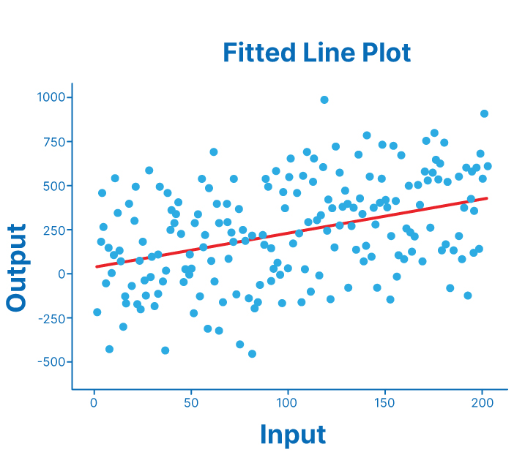
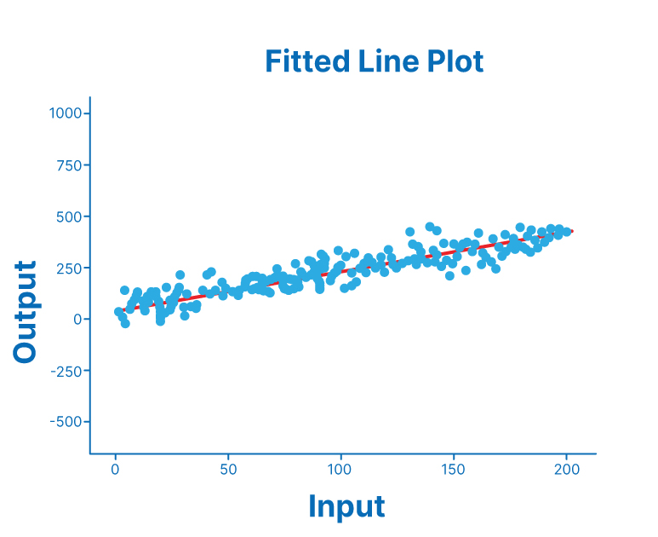
R-squared ( R²) or Coefficient of determination

Slide 9
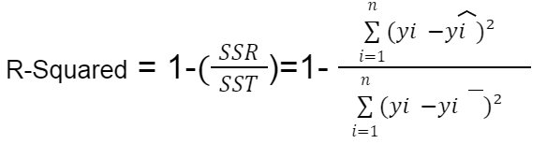
R-squared ( R²) or Coefficient of determination
where:
SSR/MSE is the sum of squared residuals (i.e., the sum of squared errors)
SST is the total sum of squares (i.e., the sum of squared deviations from the mean)

Slide 10
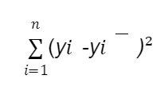

R-squared ( R²) or Coefficient of determination
The deviation of an actual value from the mean is therefore calculated as the sum of the squared distances of the individual points from the mean. This is also called the total sum of squares (SST). SST is also called total error.
The total variation of the actual values from the regression line is expressed as the sum of the squared distances between the predicted values from the regression line, also known as the Residual sum of squared error (SSR). SSR is sometimes called explanatory error or explanatory variance.

Slide 11
R-squared ( R²) or Coefficient of determination
A data set having values of X representing experience and Y representing salary. calculate R squared value.
x_{i} | y_{i}
11 | 90
10 | 45
2 | 19
8 | 35
4 | 25
20 | 80
1 | 2
9 | 30
5 | 33

Slide 12
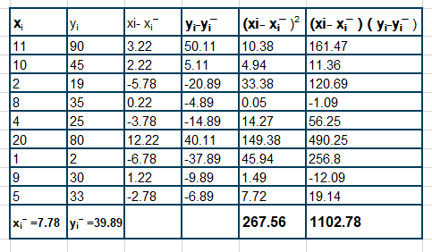
R-squared ( R²) or Coefficient of determination

Slide 13
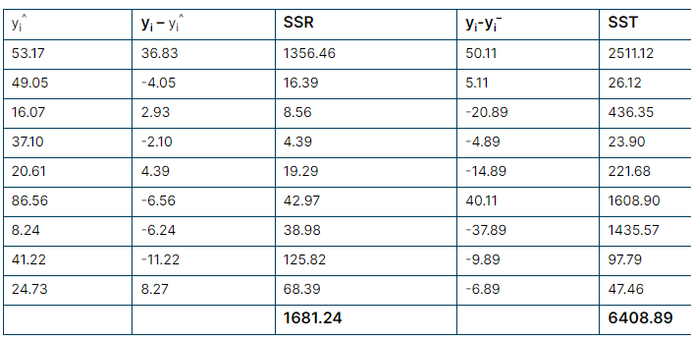
R-squared ( R²) or Coefficient of determination
R-Squared = 1-(SSR/SST).
R square= 0.74

Slide 14
R-squared ( R²) or Coefficient of determination
R squared can be misleading if you’re not careful. For example, if you have a lot of noise in your data, your r-squared value will inflate.
R-squared values don’t help in case we have categorical variables.

